Slide 1
Control Statements
Week 04

Slide 2
CONTROL STATEMENTS
Selection Statements
if
if-else
Switch
Ternary Operator ?

Slide 3
OPERATORS
<
!
>
!=
==
Operators
||
<=
>=
&&
!=

Slide 4
RELATIONAL OPERATORS
Equality and Logical Operators
To Specify | Symbol Used
less than | <
greater than | >
less than or equal to greater than or equal to | <= >=
To Specify | Symbol Used
Equal to | ==
Not equal to | !=
Logical AND | &&
Logical OR | ||
Negation | !

Slide 5
POINTS TO NOTE
If an expression, involving the relational operator, is true, it is given a value of 1. If an expression is false, it is given a value of 0. Similarly, if a numeric expression is used as a test expression, any non-zero value (including negative) will be considered as true, while a zero value will be considered as false.
Space can be given between operand and operator (relational or logical) but space is not allowed between any compound operator like <=, >=, ==, !=. It is also compiler error to reverse them.
a == b and a = b are not similar, as == is a test for equality, a = b is an assignment operator. Therefore, the equality operator has to be used carefully.
The relational operators have lower precedence than all arithmetic operators.

Slide 6
A FEW EXAMPLES
The following declarations and initializations are given:
int x=1, y=2, z=3;
Then,
The expression x>=y evaluates to 0 (false).
The expression x+y evaluates to 3 (true).
The expression x=y evaluates to 2 (true).

Slide 7
LOGICAL OPERATORS MAY BE MIXED WITHIN RELATIONAL EXPRESSIONS BUT ONE MUST ABIDE BY THEIR PRECEDENCE RULES WHICH IS AS FOLLOWS:
NOT operator
AND operator
OR operator
(!)
&&
||

Slide 8
ONE-WAY DECISIONS USING IF STATEMENT
If statement
Syntax:
if ( Condition ) {
True Part
}
else {
False part
}
if ( Condition )
True Part (only one line)
else
False part (only one line)

Slide 9
ONE-WAY DECISIONS USING IF STATEMENT
Flowchart for if construct
if(TestExpr)
stmtT; T F
TestExpr
stmtT

Slide 10
TWO-WAY DECISIONS USING IF-ELSE STATEMENT
Flowchart of if-else construct
The form of a two-way decision is as follows:
if(TestExpr)
stmtT;
else
stmtF;
TestExpr
stmtT
stmtF

Slide 11
Week 4
Class 2

Slide 12
Question
Write a program to test whether the input number is even or odd.

Slide 13
Question
Write a program that prints the largest among two given numbers.

Slide 14
FLOWCHART OF AN IF-ELSE-IF CONSTRUCT
TestExpr
TestExpr2
TestExpr3
stmtT1
TestExprN
stmtT2
stmtT3
stmtTF
stmtTN

Slide 15
Week 4
Class 3

Slide 16
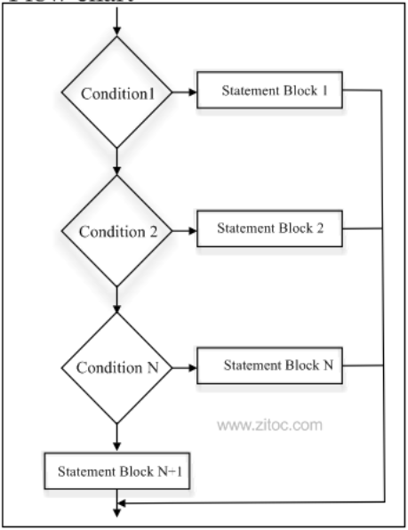
Multiple Decision Structure

Slide 17
MULTI-WAY DECISIONS
if-else-if ladder
General format of switch statements
if(TestExpr1)
stmtT1;
else if(TestExpr2)
stmtT2;
else if(TestExpr3)
stmtT3;
.. .
else if(TestExprN)
stmtTN;
else
stmtF;
switch(expr)
{
case constant1: stmtList1;
break;
case constant2: stmtList2;
break;
case constant3: stmtList3;
break;
………………………….
………………………….
default: stmtListn;
}

Slide 18
THE FOLLOWING PROGRAM CHECKS WHETHER A NUMBER GIVEN BY THE USER IS ZERO, POSITIVE, OR NEGATIVE

Slide 19
NESTED IF
When any if statement is written under another if statement, this cluster is called a nested if.
The syntax for the nested is given here:
Construct 1 | Construct 2
if(TestExprA) if(TestExprB) stmtBT; else stmtBF; else stmtAF; | if(TestExprA) if(TestExprB) stmtBT; else stmtBF; else if(TestExprC) stmtCT; else stmtCF;

Slide 20
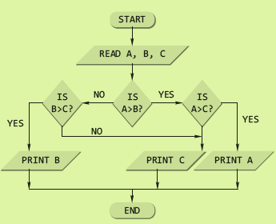
A PROGRAM TO FIND THE LARGEST AMONG THREE NUMBERS USING THE NESTED LOOP
#include <stdio.h>
int main()
{
int a, b, c;
printf(“\nEnter the three numbers”);
scanf(“%d %d %d”, &a, &b, &c);
if(a > b)
if(a > c)
printf(“%d”, a);
else
printf(“%d”, c);
else
if(b > c)
printf(“%d”, b);
else
printf(“%d”, c);
return 0;
}

Slide 21
Week 5
Class 1

Slide 22
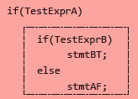
DANGLING ELSE PROBLEM
This classic problem occurs when there is no matching else for each if. To avoid this problem, the simple C rule is that always pair an else to the most recent unpaired if in the current block. Consider the illustration shown here.
The else is automatically paired with the closest if. But, it may be needed to associate an else with the outer if also.

Slide 23
Question
Write a program to print whether the input is a digit or a character. If it is a character then is it a small character or a capital character.

Slide 24
SOLUTIONS TO DANGLING ELSE PROBLEM
Use of null else
Use of braces to enclose the true action of the second if
With null else | With braces
if(TestExprA) if(TestExprB) stmtBT; else ; else stmtAF; | if(TestExprA) { if(TestExprB) stmtBT; } else stmtAF;

Slide 25
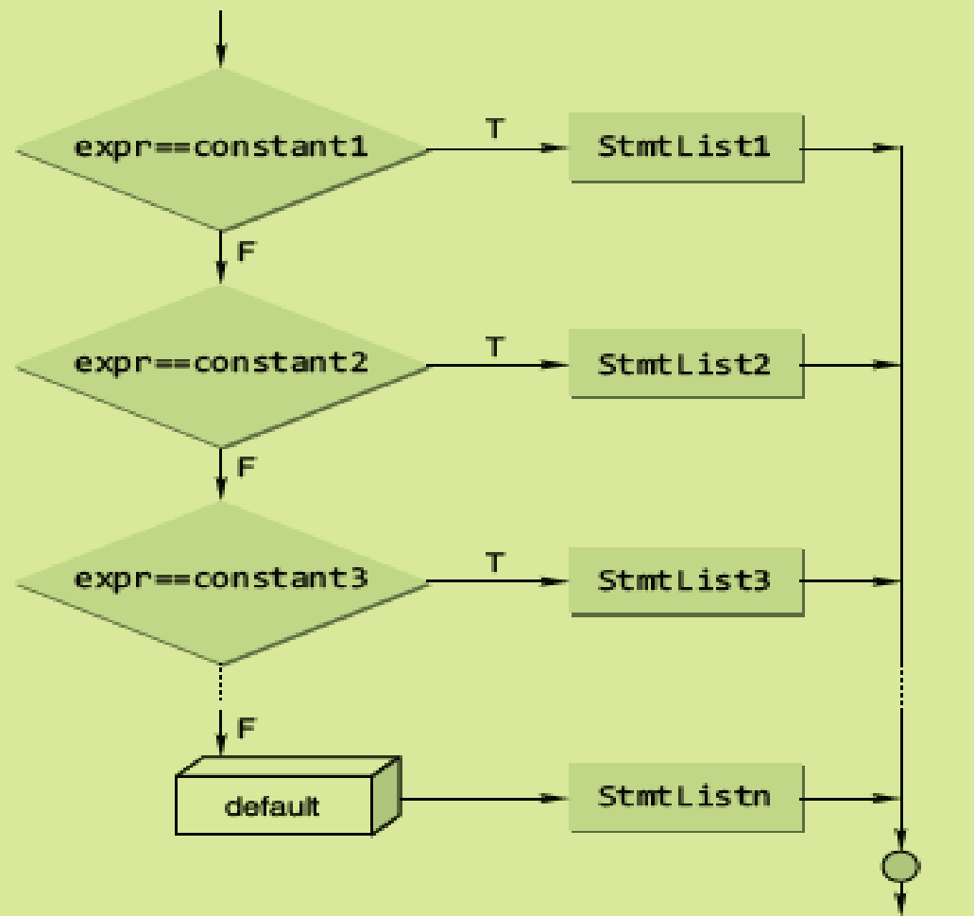
THE SWITCH STATEMENT
The C switch construct
The general format of a switch statement is
switch(expr)
{
case constant1: stmtList1;
break;
case constant2: stmtList2;
break;
case constant3: stmtList3;
break;
………………………….
………………………….
default: stmtListn;
}

Slide 26


THE CONDITIONAL OPERATOR
It has the following simple format:
expr1 ? expr2 : expr3
It executes by first evaluating expr1, which is normally a relational expression, and then evaluates either expr2, if the first result was true, or expr3, if the first result was false.
An Example
#include <stdio.h>
int main()
{
int a,b,c;
printf(“\n ENTER THE TWO NUMBERS:”);
scanf(“%d %d”, &a, &b);
c=a>b? a : b>a ? b :-1;
if(c==-1)
printf(“\n BOTH NUMBERS ARE EQUAL”);
else
printf(“\n LARGER NUMBER IS %d”,c);
return 0;
}

Slide 27
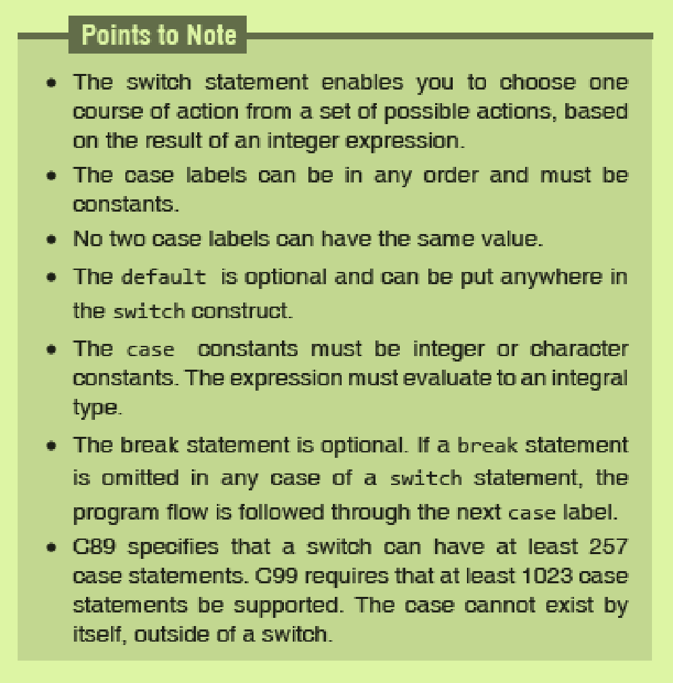

Slide 28
SWITCH VS NESTED IF
The switch differs from the else-if in that switch can test only for equality, whereas the if conditional expression can be of a test expression involving any type of relational operators and/or logical operators.
A switch statement is usually more efficient than nested ifs.
The switch statement can always be replaced with a series of else-if statements.

